Slide 1
Nutritional Detoxification: A Clinician’s Perspective
Mark Hyman, MD
Chairman
Institute for Functional Medicine
December 3, 2010

Slide 2
For practice tools and professional newsletter go to www.drhyman.com/IHS

Slide 3
Obesogens: 73% increase in obesity in 6 month old babies since 1980

Slide 4
Recent Headlines:
Toxins and Disease
Circulation: Pb > 2 mcg/dl increase risk MI 151%, CVA 89%, total and CV mortality 25% and 55% - at risk: 39% of population
Nearly 40% of Americans have blood lead > 2 mcg/dl
JAMA: Arsenic increases risk diabetes
JAMA: Bisphenol A increase risk for CV disease, diabetes and elevated GGT

Slide 5
Recent Headllines
J Am Coll Cardiology: idiopathic CHF 22,000 times Hg level in heart muscle biopsy vs control
NY Times: Toxic Tap Water
Environmental Health Perspectives: PCB’s and chlorinated pesticides increase of diabetes

Slide 6


Slide 7
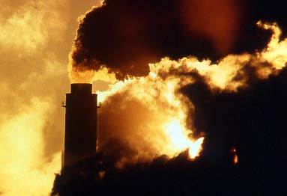

Slide 8
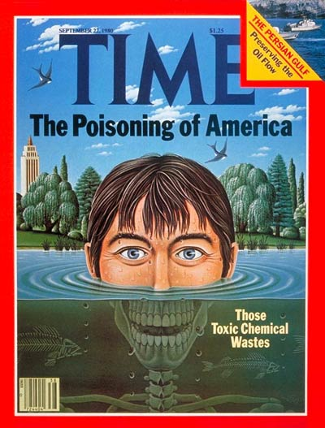

Slide 9
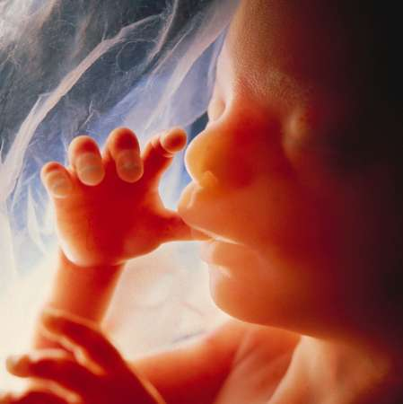
Environmental working group found 287 toxins in the average umbilical cord blood of newborns. (www.ewg.org)

Slide 10


Slide 11
Autism and ASD
A Holographic Model
for Chronic Disease

Slide 12
Autistic Boy: Son of Pfizer VP
Maximal vaccination schedule
Normal development until MMR at 22 months
Over next 2 months, severe language and social regression
Diagnosis: Regressive Autism
Told no therapy except CBT

Slide 13
Functional Assessment
Gut/Immune
  IgG anti-gliadin antibodies 91 (nl < 20)
  Elevated eosinophil protein X, calprotectin high
  Stool culture – three species yeast, NG LB, BB
  D-lactate - small bowel overgrowth
  Urine Peptides: IAG, deltorphins, enkephalins high
Nutritional Imbalances
  Homocysteine 3.0 (impaired methylation)
  Urinary MMA elevated
  Magnesium and zinc deficiency
  Vitamin A deficiency
  Omega-3 fatty acid deficiency

Slide 14
Functional Assessment
Detoxification Imbalances
  Metals – Hair: antimony, lead, and mercury (minimal)
  Urine DMPS challenge Hg 14
  Elevated urinary porphyrins
  GSH low - pyroglutamate high, sulfate low
  SNPs – GSTP1 ++ x 2, COMT, and MTHFR
Mitochondria and Oxidative Stress
  8OHDG oxidative stress, mitochondrial dysfunction, carnitine deficiency, lactic acidosis

Slide 15
Follow Up 4 months
Initial Tx: Gluten and dairy elimination
  3 weeks – dramatic improvement in verbal communication and social engagement
Gut Repair
  Rifixamixin, fluconazole, enzymes, probiotics, S. boulardii
Nutrient Support
  MVI with B6, Zn, cod liver oil, Mg, GSH topical, CoQ10
MeB12 high dose 3 x a week
Detox: DMSA oral chelation
Mainstream school after 4 months
  More focused, unstuck, uses more words

Slide 16
10 Month Follow Up
Verbally fluent
Mainstream school (“loss” of diagnosis)
Bowel movements normal
Tx: Continue treatment until metals nl, gut nl and porphyrins and OA nl

Slide 17
10 Month Laboratory Follow Up
Gut Function
  EPX and calprotectin normalized
  SBBO overgrowth normalized – D-lactate
  Mild yeast overgrowth
MMA still elevated (impaired methylation)
Improved detoxification
  GSH markers normal (pyroglutamate, sulfate)
  Porphryins elevated
  UTE pending
Mitochondrial dysfunction improved
  Lactate reduced from 100 to 50
  oxidative stress nl 8OHDG, kreb cycle markers nl

Slide 18
2 year follow up
Metal normal
Porphryins normal
Organic acids normal
Gut normal
Child normal!

Slide 19
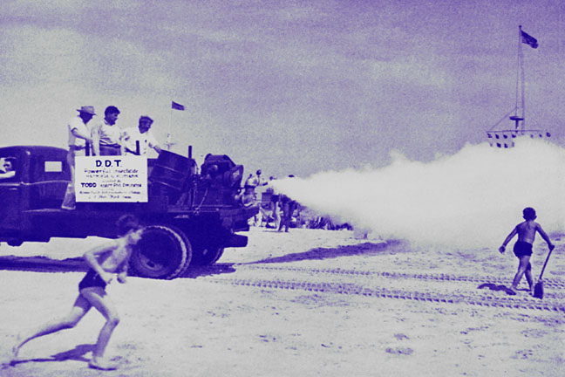

Slide 20
Exposure to Toxicants
Since WWII, more than 85,000 new synthetic chemicals have been released into the environment.
Less than 50% have been tested for potential toxicity to adult humans (almost none for children).
Over 4 billion pounds of pesticides are used annually in the U.S.
Coal burning plants release 6 million lbs/yr of Hg into environment and 15% of women of childbearing age have toxic levels of Hg in blood (600,000 babies)
Current law allows 350 different pesticides to be used on the food we eat.
The average home contains 3-10 gallons of hazardous materials.

Slide 21
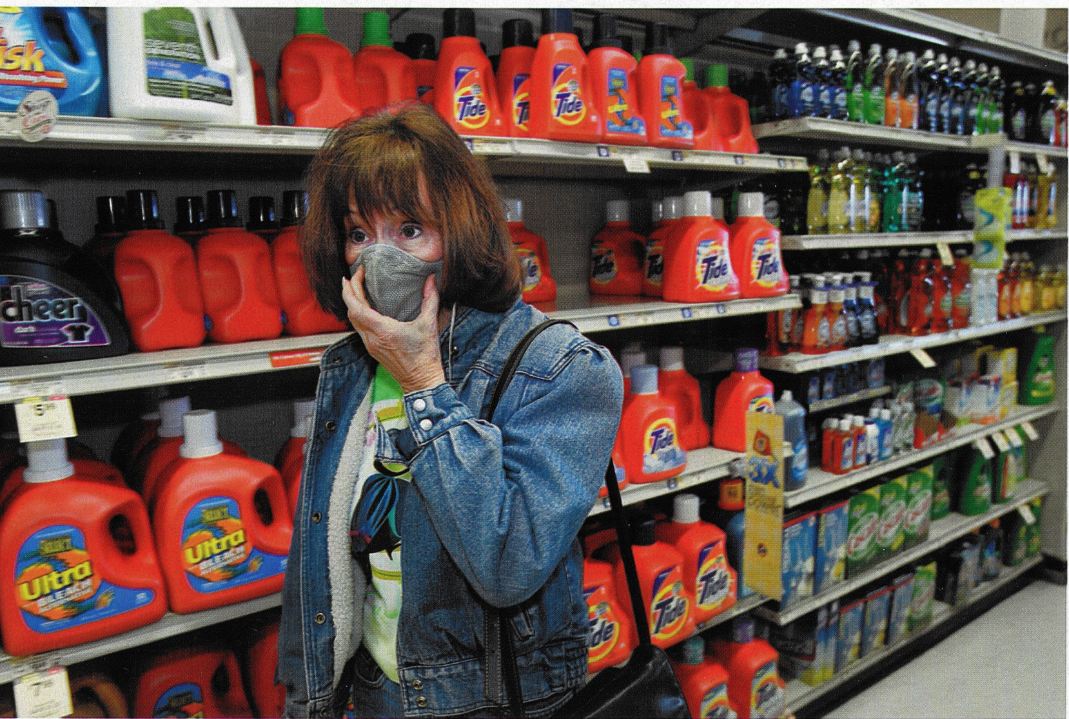

Slide 22
Traces of > 400 synthetic chemicals can be found in the average human.

Slide 23
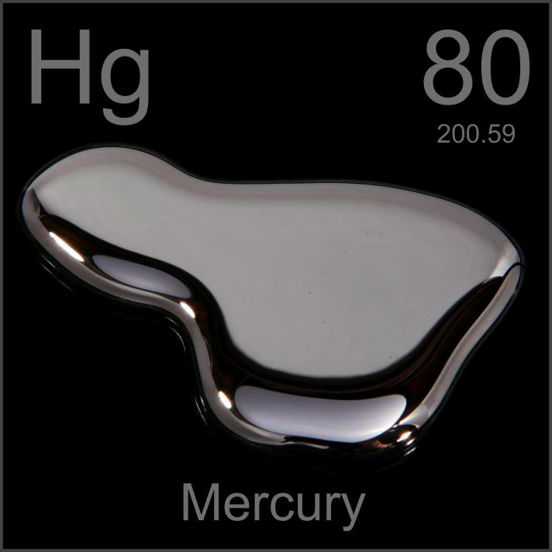

Slide 24


Slide 25
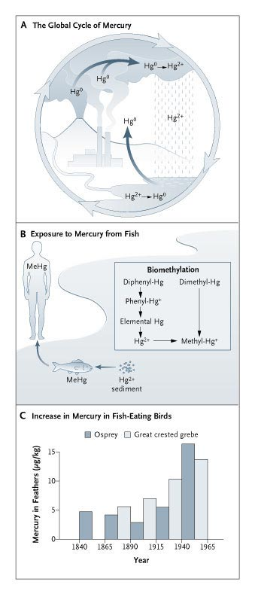


The Global Cycle of Mercury
Clarkson T et al. N Engl J Med 2003;349:1731-1737
Notes:
Figure 1. The Global Cycle of Mercury. In nature, mercury vapor (Hg0), a stable monatomic gas, evaporates from the earth's surface (both soil and water) and is emitted by volcanoes (Panel A). Anthropogenic sources include emissions from coal-burning power stations and municipal incinerators. After approximately one year, mercury vapor is converted to a soluble form (Hg2+) and returned to the earth in rainwater. It may be converted back to the vapor form both in soil and in water by microorganisms and reemitted into the atmosphere. Thus, mercury may recirculate for long periods. Mercury attached to aquatic sediments is subject to microbial conversion to methyl mercury (MeHg), whereupon it enters the aquatic food chain. It reaches its highest concentrations in long-lived predatory fish, such as sharks. Panel B indicates the routes of transformation to methyl mercury as originally suggested by Jernelov.26 Panel C depicts the increase in mercury concentrations in feathers of fish-eating birds in Sweden.27 The period covered by these data corresponds approximately to the growth of industrialization in Sweden.

Slide 26
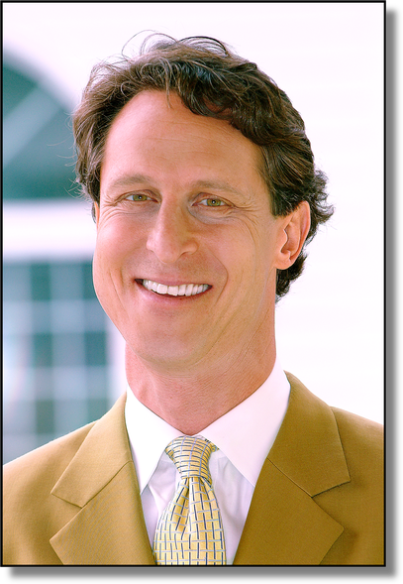
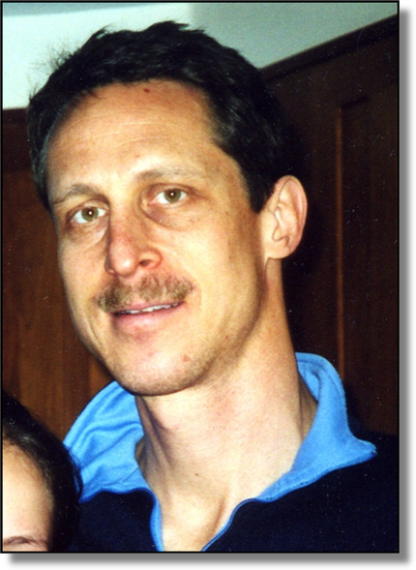

Slide 27
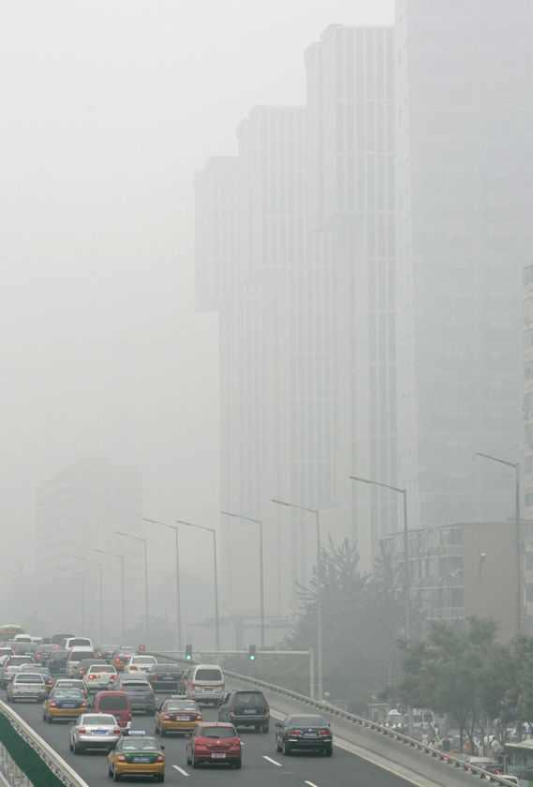

Slide 28
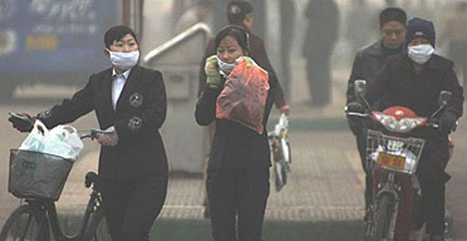

Slide 29
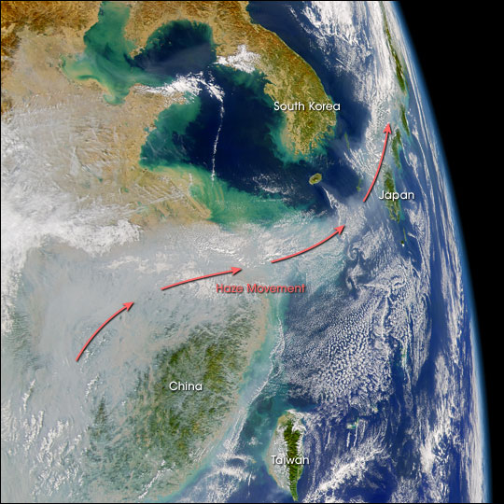

Slide 30
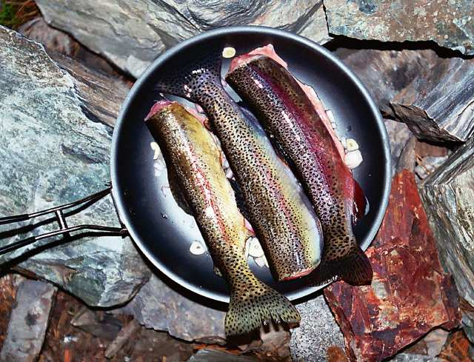

Slide 31
Recent study conducted by the U.S. Geological Survey, sampled 34 fish species at 291 stream sites across the country from 1998 to 2005.
Mercury toxicity found for nearly all who ate a normal amount of river fish.

Slide 32
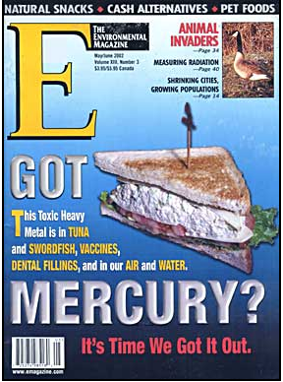
Mercury
Fish
Water
Paint
Dental Amalgams
Cement Plants
Toxic Effluent
Medical Incinerators

Slide 33
Scope and Sources of Problem
If you look you will find it:
Amalgams score correlates with brain concentration of Hg
Autism risk 3 x higher excretion on DMSA challenge
Hg excretion and Neurodegenerative Dx
The Toxicology of Mercury: Clarkson T et al. N Engl J Med 2003;349:1731-1737

Slide 34

“The Smoking Tooth”

Slide 35
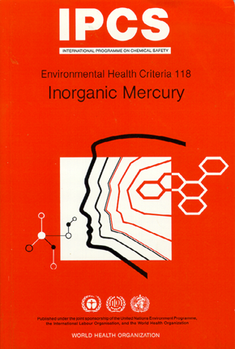
Mercury
According to the World Health Organization's expert committee, the daily human exposure to mercury vapor from amalgam fillings ranges from 3μg to 17μg compared to a maximum of 2.6μg from all other sources.

Slide 36
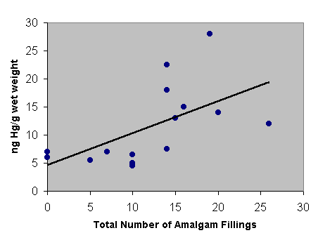
Mercury concentrations in the occipital cortex vs. number of amalgam fillings.
Nylander M, Friberg L, Lind B, & Kullman L: Mercury in the central nervous system correlated to dental amalgam fillings, Lakartidningen 1986 Feb 12;83(7):519-22

Slide 37
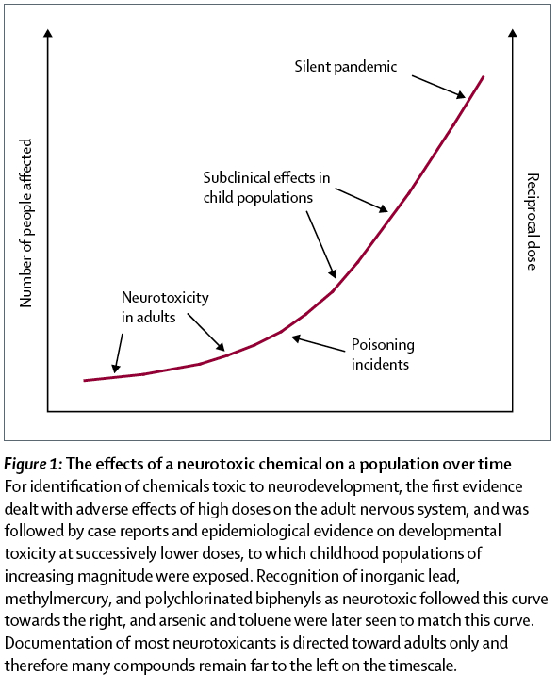

Slide 38
Health Effects
Children
  Developmental problems (1 in 6 children)
  Autism (> 1000% increase in 10 years)
  ADHD/Behavioral Problems
  Violent behavior and conduct disorder
  Immune problems
  Allergy and respiratory disease (asthma)

Slide 39

Children are the ‘canaries’ of the human world – they are highly affected by their environment.

Slide 40
General Health Effects
Increase risk of death from all causes
What diseases do toxins increase risk of:
  Heart disease, stroke, heart attacks, dementia
  High blood pressure
  Diabetes and obesity
  Cancer
  Autoimmune and allergic diseases
  Psychiatric and mood problems (depression)

Slide 41
Symptoms of Toxicity
Fatigue
Muscle aches
Joint pain
Sinus congestion and postnasal drip or excessive congestion
Headaches
Bloating, gas, constipation or diarrhea
Foul smelling stools
Heartburn
Sleep problems
Difficulty concentrating or brain fog
Food cravings
Fluid retention
Excess weight or trouble losing weight
Skin rashes (boils, pimples, acne)
Canker sores
Puffy eyes and dark circles under eyes
Menstrual disorders
Bad breath

Slide 42


Slide 43
Precautionary Principle
“We (as physicians) must act on facts … and on the most accurate interpretation of them, using the best scientific information. That does not mean that we must sit back until we have 100% evidence about everything. When the state of the health of the people is at stake … we should be prepared to take action to diminish those risks even when the scientific knowledge is not conclusive.”
Horton. Lancet. 1998;352(9124):251

Slide 44
A Clinical Model for Nutritional and Metabolic Detoxification
Heavy Metal Detoxification

Slide 45
Disclaimer: Re Treatment
What you are about to hear is my opinion
Based on treatment of 100’s of patients with heavy metal toxicity
Based on basic science, small clinical studies, inference and extrapolation, not large clinical trials which are urgently necessary
Based on treatment of my own mercury toxicity
Focus on mercury but applies equally to Pb, Ar, antimony, etc. and other POP’s (persistent organic pollutants)

Slide 46
Nutritional and Metabolic Detoxification
Heavy Metals: An Clinical Example
What works
What might work
What doesn’t work
Myths and Controversies

Slide 47
Empirical Overview
Scope of Problem
Sources of Toxicity
Genetic Susceptibility
Biology of Detoxification: Methylation-Sulfation
Clinical Diagnosis
Laboratory Evaluation
  Laboratory Diagnosis of Metal Toxicity
  Pre-Treatment Laboratory Evaluation
  Ancillary Laboratory Evaluation

Slide 48
Aspects of Treatment
Removal of Sources of Toxins
Preparation for Treatment
Dental Amalgams: Controversies and Caveats
When to Start Treatment
Treatment

Slide 49
Treatment: Metal Detoxification
Chelation Methods and Options
Food and Phytonutrients
Use of Supplements
Use of intravenous therapies
Adjunctive Treatments
Management of Side Effects and Problems
When to Stop
Pitfalls, Risks and Pearls

Slide 50
Depressed or Poisoned?

Slide 51
Depression: A Case Study
36 year old professional woman
A decade of depression
Fatigue, weight gain, and fibromyalgia
Severe PMS and FCBD
Tried Prozac and OCP without benefit
Sugar addict
Frequent antibiotics, sinus and yeast infections
Dry skin, soft nails and thinning hair

Slide 52
Lab Testing
High hs-CRP 4.3
High lymphocytes, low neutrophils (yeast)
Folate and B6 deficient
Borderline thyroid function and elevated auto-antibodies
Mercury toxic - 260 (nl < 3)

Slide 53
Comprehensive Treatment
Antifungals
Sinus irrigation
Nutrients and Herbs
  Mg, B6, folate
  EFA and evening primrose oil
  Herbs for PMS
Hg Treatment - methylation, sulfation, amalgam removal, DMSA
Reduction of Hg from 260 to 150 to 27 to 10
Resolution of depression, fatigue, FMS and lost 42 lbs without trying

Slide 54
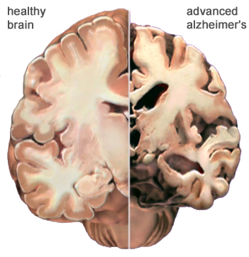

Slide 55
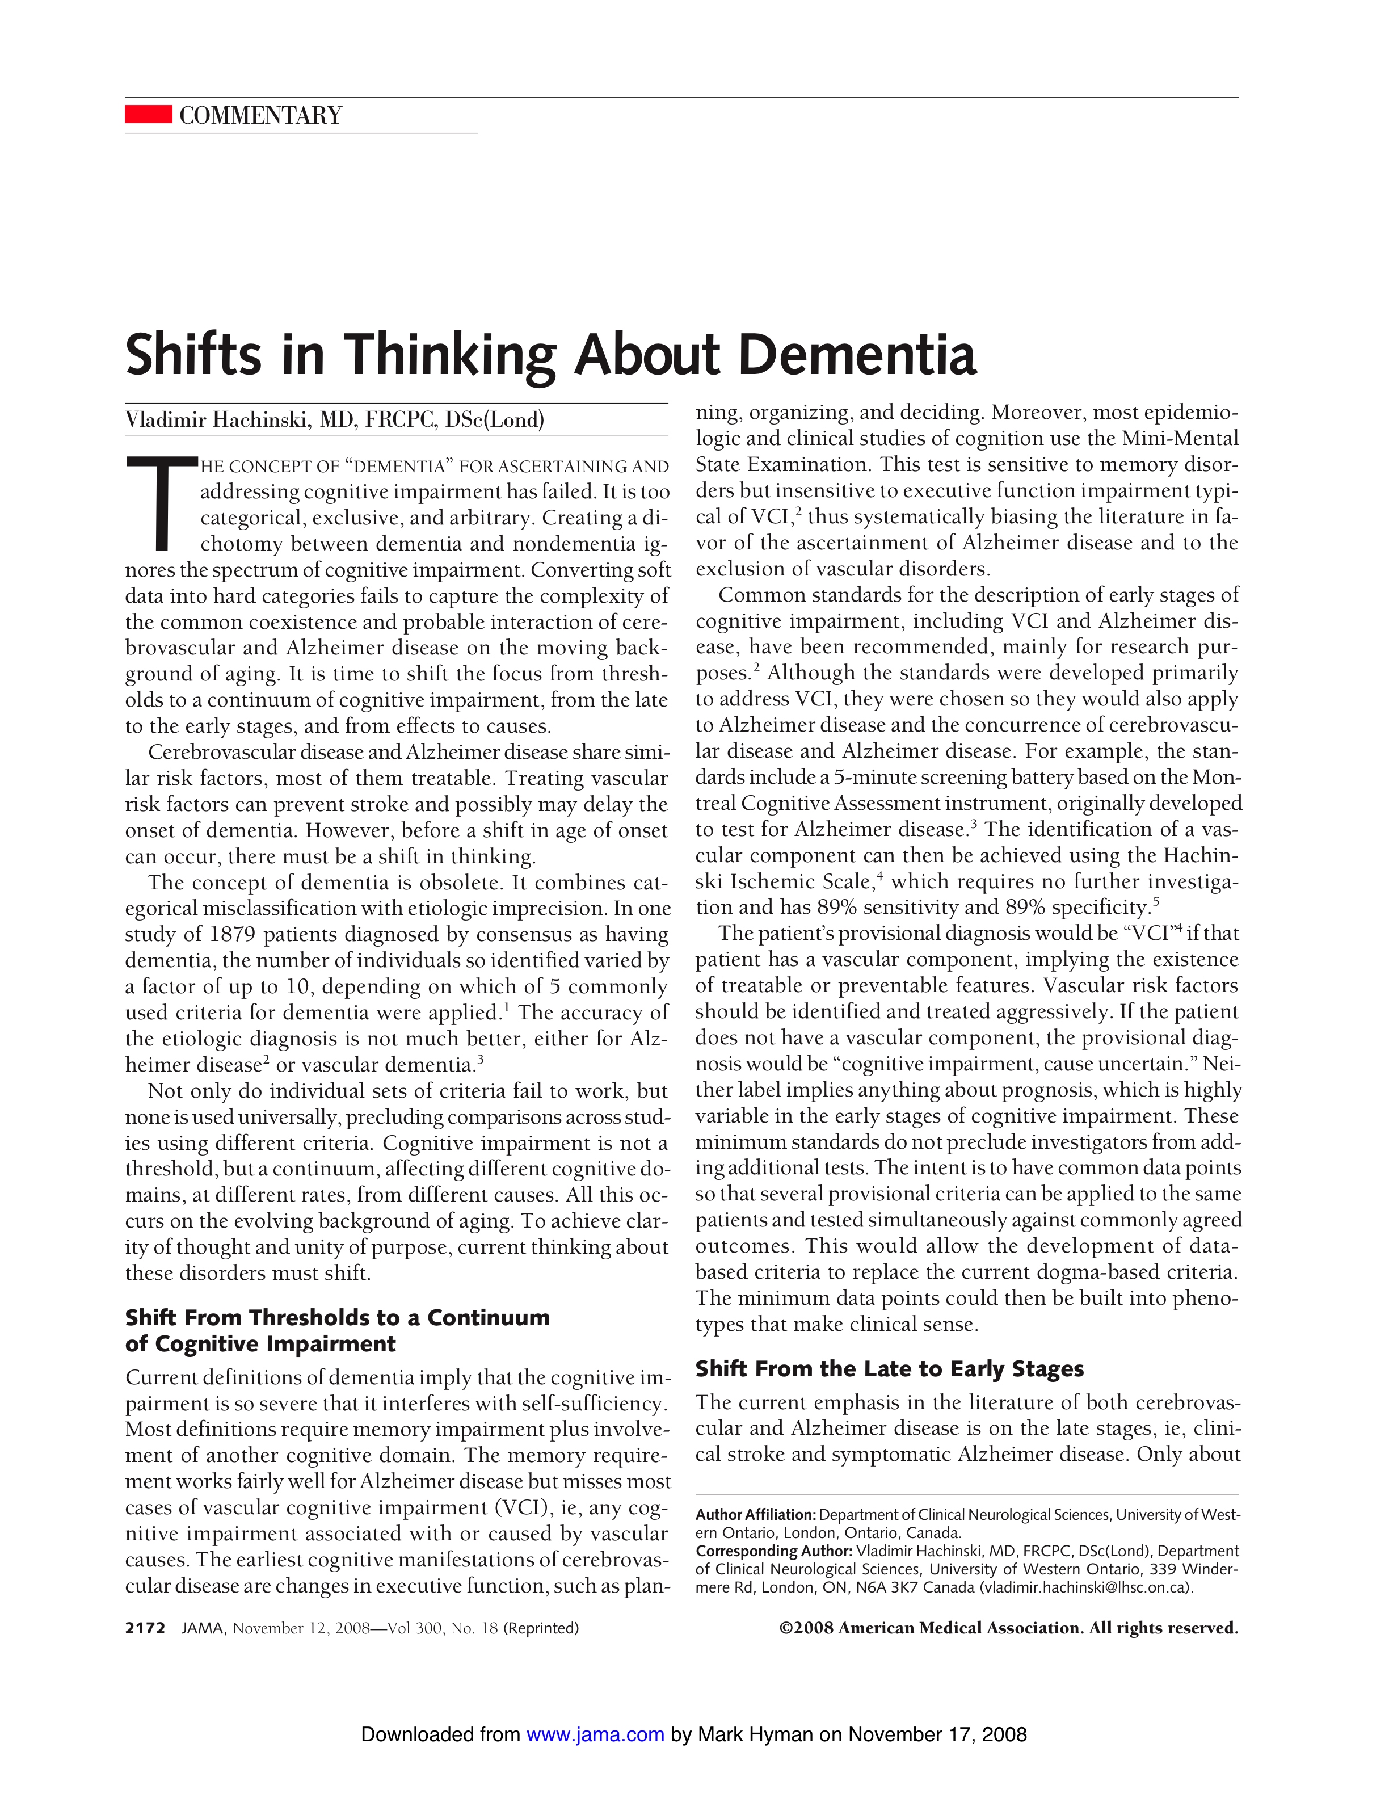
The concept of dementia is obsolete. It combines categorical misclassification with etiologic imprecision.
JAMA, November 12, 2008—Vol 300, No. 18

Slide 56
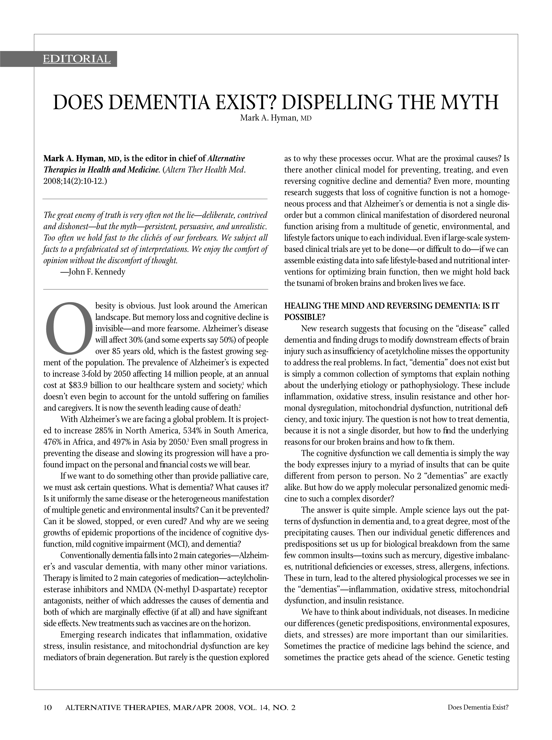

Slide 57
Does Dementia Exist?
70 year old man with recent dx dementia
Genetic predisposition: ApoE 4, MTHFR, GSTM1 absent, CETP
Phenotype: hyperlipidemia, insulin resistance, hyperhomocysteinemia, low glutathione
Elevated Hg 350 (nl < 3 micrograms/gr Cr)
30 yr history irritable bowel syndrome

Slide 58
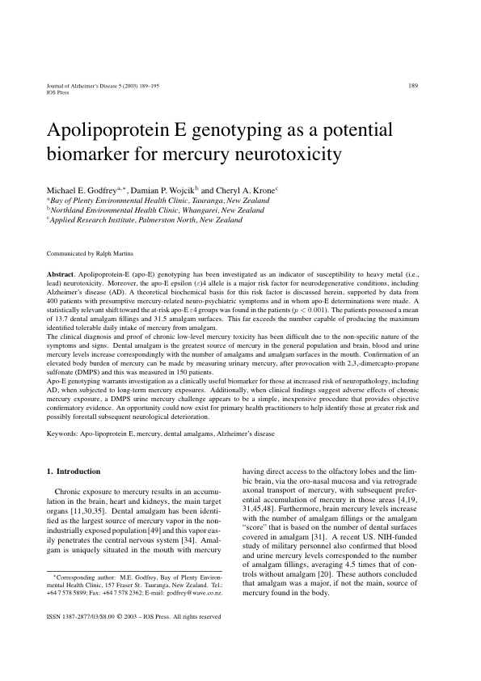
DMPS urine Hg challenge appears to be a simple, inexpensive procedure that provides objective confirmatory evidence. An opportunity could now exist for primary health practitioners to help identify those at greater risk and possibly forestall subsequent neurological deterioration.

Slide 59
Treatment
Remove toxic triggers: diet, food allergens, dysbiosis, Hg
Small bowel overgrowth tx, probiotics
Low glycemic load, anti-inflammatory allergen free diet
Safe amalgam removal, DMSA and DMPS chelation
Phytonutrients to increase GSH
Essential fatty acids
Detox Minerals: Zn, Se
Methylation support: 5-MF, MeCbl, B6
RESULTS: Recovery from “dementia” stable at 3 years

Slide 60
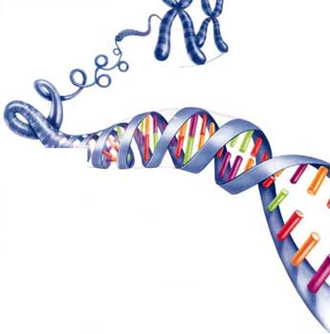

Slide 61
Genetic Susceptibility: SNP’s
Impaired Methylation
  MTHFR (Methylenetetrahydrofolate reductase)
  MS (methionine synthase)
  COMT (catechol-O-methyltransferase)
  Methyl-transferrases
Impaired Sulfation SNP’s
  GSTM1, GSTP1 (glutathione transferases)
  Apo E 4 (apolipoprotein E 4)
Impaired Metallothionein Function

Slide 62
Biology of Metal Toxicity
Enzyme disruption
  Irreversibly binds to sulfhdryl groups (SH) on enzymes (like MS and porphryins)
  Lowers glutathione
Direct cellular and neurotoxin
  Mitochondria toxin and increases oxidative stress
  Dose dependent
Immunotoxicity
  Low level toxicity – dose independent
  Autoimmunity

Slide 63
Neurochemistry of Mercury Poisoning
Disrupts serotonin metabolism
Alters dopamine system
Increases glutamate
Poisons enzyme that degrades epinephrine
Decreases muscarinic (acetylcholine) binding density in hippocampus and cerebellum

Slide 64
Impaired Metallothionein:
Native Intracellular Metal Chelator
Inability to handle toxic metals
Oxidative stress
Decrease in reduced glutathione
Pro-inflammatory state
Zinc depletion

Slide 65
Biology of Detoxification:
Genetics, Environment, Nutrients
The central role of methylation and sulfation in health and in diagnosis and treatment of chronic illness and metal toxicity

Slide 66
Methylation/Sulfation Abnormalities

Slide 67
Cysteine
Healthy
Glial Cells
(Astrocytes)
Cysteinylglycine
GSH
Glutamate
EAAT3
( + )
GSSG
GSH
GSCbl
PI3-kinase
OHCbl
SAM
γ-Glutamylcysteine
MeCbl
PARTIALLY BLOCKED IN NEURONAL CELLS
Cysteine
H₂S
Cystathionine
Adenosine
Adenosine
D4SAH
D4HCY
HCY
SAH
MethylTHF
( - )
Phospholipid
Methylation
MethylTHF
  >150
  Methylation
  Reactons
Methionine
Synthase
THF
THF
D4SAM
D4MET
MET
SAM
PP+P_{i}
ATP
ATP
PP+P_{i}
Dopamine
Notes:
67

Slide 68
Clinical Diagnosis
Heavy Metal Toxicity
Marked sensitivity to environmental chemicals, odors, medications, and/or nutritional supplements
Chronic, debilitating fatigue and lethargy
Depression, anxiety, and/or mood swings
Insomnia
Cognitive dysfunction (poor memory and concentration, learning disorders)
Recurrent headaches
Muscle aching and weakness
Recurrent infections
Infertility

Slide 69
Identifying Antecedents and Triggers
History of Exposure and Total Load:
Home
Hobbies
Occupation (such as being around solvents or pesticides regularly)
Personal habits
Diet (fish consumption)
Medications
Dental amalgams
Vaccination history (flu, etc.)
Phthalate exposure (high level is an endocrine disruptor)
Notes:
History of toxin exposure from work, home, or the environment
Mercury fillings (numerous)
Phthalate exposure (high level) with endocrine disruption
Work environment such as being around solvents or pesticides regularly
Hobby environment
Multiple Chemical Sensitivity is an antecedent condition after it develops

Slide 70
Laboratory Diagnosis of Metal Toxicity
Hair analysis
  Current methlymercury consumption
Whole blood analysis
  Current exposure
Urine Provocation Testing (DMSA or DMPS)
  Total Body Burden
  DMSA 30 mg/kg 6 hour urine collection
  DMPS 10 mg/kg or 500 mg max dose 6 hour urine
  Pre and post provocation analysis?
  What is normal?

Slide 71
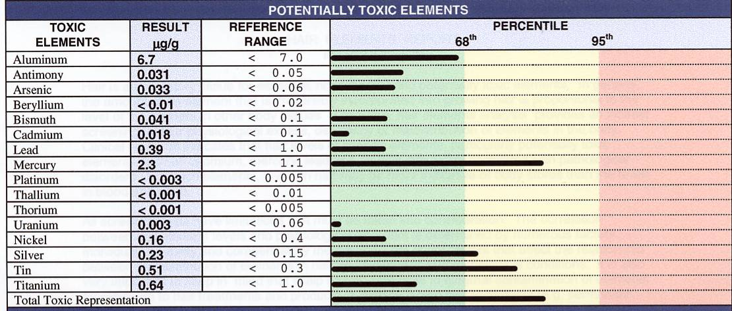
Hair Analysis

Slide 72
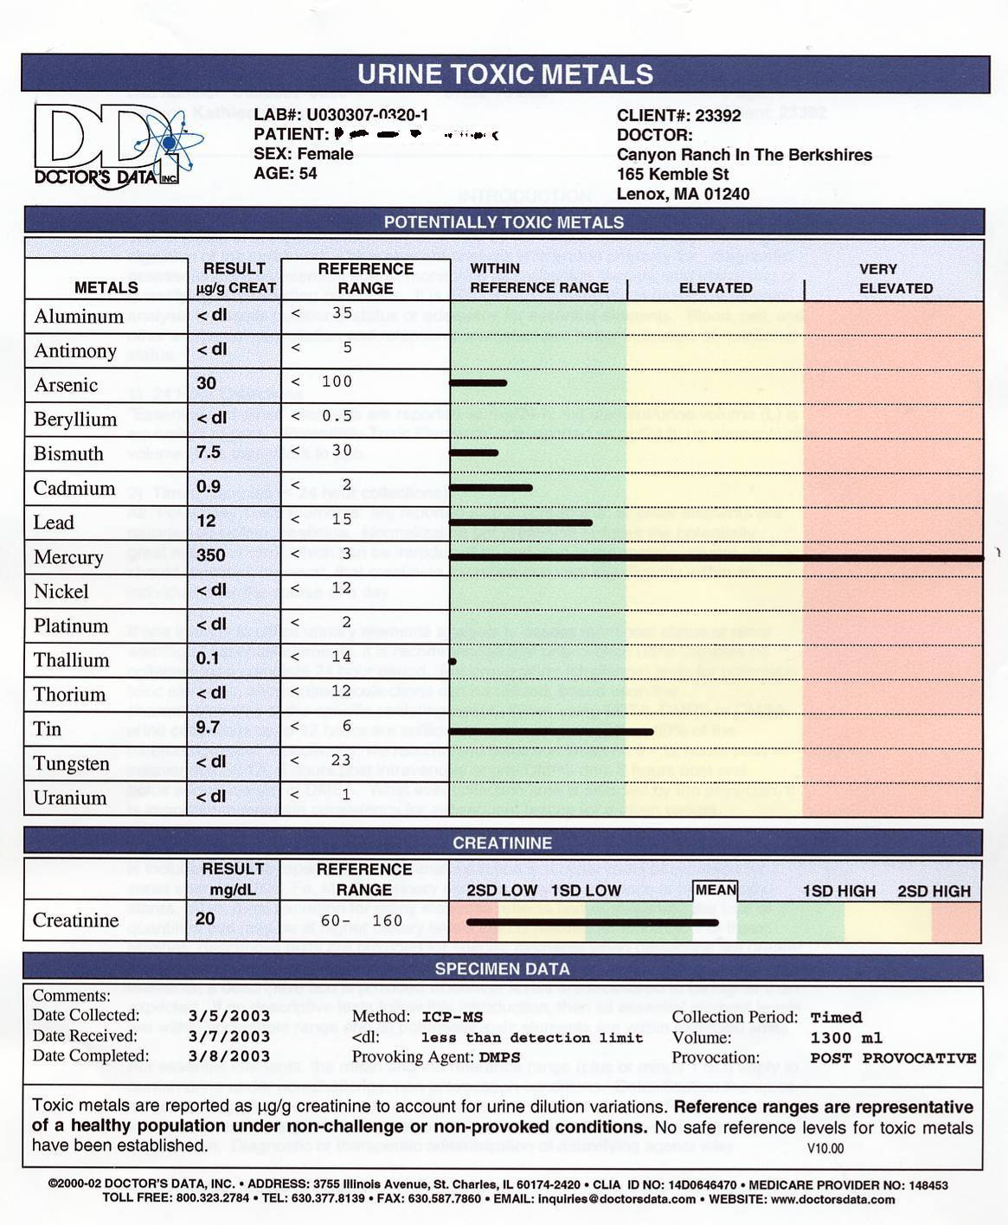
Urine Toxic Metals

Slide 73
Pre-Treatment Laboratory Evaluation
Mineral analysis (Zn, Se, Mg)
Amino acid analysis (phase 2 detox)
Methylation assessment
  Folate status
    Homocysteine, FIGLU (organic acids)
  B12 Status
    Serum or urinary methylmalonic acid
  B6
    xanthenurnate, kynurenate (organic acids)
  Genomics
    MTHFR, Apo E genotyping, COMT, GSTM1, GSTP1

Slide 74
Pre Treatment Laboratory Evaluation
Glutathione Status
  Reduced GSH
  Urinary pyroglutamate and sulfate
  GSTM1 and GSTP1 SNP’s
Urinary Porphryins
  Impaired iron metabolism
Challenge Testing Phase 1 and Phase 2 detox
Redox Status
  Lipid peroxides
  Urinary 8 0HDG (organic acids)

Slide 75
Ancillary Laboratory Evaluation
Basic lab evaluation
  CBC, LFT’s, renal function
Immune Dysfunction
  Melisa Testing
  Autoantibodies (ANA, SSA, SSB, RF, ScL-70, anti-CCP, ds-DNA, anti-cardiolipin antibodies, celiac antibodies)
  Myelin basic protein antibodies
  Food sensitivities – IgG
Gut Evaluation
  Urinary dysbiosis markers
  Comprehensive stool analysis, DNA microbiology

Slide 76
Genomic Testing for Detoxification
When to Order?
  Patient with multiple chemical sensitivity
  Patient with hx of multiple drug reactions
  Patient with a history of side effects to a class of medications
  Patient with refractory mood disorder or fatigue
  Patient with a difficult case of fibromyalgia
  Patient with a story of a triggering event of an exposure to toxins
  Patient with chronic pain

Slide 77
General Principles: Detoxification
Reduce Toxic Load: Minimize exposure
Increase Mobilization: Toxic metal chelation as necessary
Maximize Biotransformation: Balanced, effective, and supported phase I and II detoxification
Minimize Redistribution: Bowel health and the 4R program

Slide 78
Preparation for Treatment: 3 Months
Remove sources of toxins
  Fish (Hg containing)
  Dental amalgams
Fix the gut (4R program)
  Importance of fiber and regular BM
Optimize Detoxification Routes
  urine, stool, sweat – saunas
Optimize Antioxidant Status
  Dietary phytonutrients
  Buffered vitamin C, vitamin E, CH3-SH chemistry

Slide 79
Preparation: Optimize Nutrient Status
Detoxification diet (crucifers, allium, green tea, protein)
Adequate mineralization (Zn, Se, Mg especially)
Amino acid replacement (empiric or based on testing)
Optimization methylation and sulfation status
  Methyl folate, methylcobalamin, B6, TMG, NAC, whey protein
Herbal support (milk thistle, garlic)

Slide 80
FIGURE 9.3 Liver detoxification pathways and supportive nutrients, p. 254 in Clinical Nutrition

Slide 81
Dental Amalgams?
Documented source of Hg
Removal associated with 50% or more reduction in body burden on provocation testing
Safe removal essential - www.iaomt.org
Support during removal – options
Chelation before, during and after?

Slide 82
Treatment of
Metal Toxicity

Slide 83
Treatment
Continue “pre-treatment” strategies
  Gut support, minerals, amino acids, sulfation/methylation support, antioxidants, herbs
Chelating Agents (DMPS, DMSA, Ca-ETDA)
  Informed consent needed
Intravenous Support (GSH, vitamin C, PC)
Fluids, fiber, exercise
Sauna Therapy

Slide 84
Chelation Options
First line: oral DMSA
10 mg/kg divided bid-tid 3 days on 11 days off
Compounding pharmacies
Standard doses
  100 mg bid for children
  250 mg bid for adults
Duration of Therapy – as long as it takes
Considerations: Redox and mineral replacement
Side effects: gas, bloating, yeast overgrowth, fatigue, Steven’s Johnson, or Erythema multiforme (rare)
Alternative delivery: suppositories, creams

Slide 85
Chelation Options
Second line: oral DMPS (40% better absorption)
10 mg/kg divided bid-tid 3 days on 11 days off
Compounding pharmacies
Standard doses
  100 mg bid for children
  200 mg bid for adults
Duration of Therapy – as long as it takes
Considerations: Redox and mineral replacement
Side effects: yeast overgrowth, fatigue, Steven’s Johnson, or Erythema multiforme (rare)
Alternative delivery: suppositories, creams, intravenous

Slide 86
Ca-ETDA
More lead specific
Intravenous most common but suppositories effective
Compounding pharmacies or Detoxamins

Slide 87
Adjunctive Use of Supplements
Support Phase 1 and Phase 2 Detox
Essential
  Multivitamin and mineral
  Additional zinc citrate 20-50 mg/d
  Additional selenium 100 – 200 mcg/d
  Methylation support (B6, MF, MeCbl)
  GSH support (NAC, lipoic acid, whey protein, milk thistle, green tea, elagic acid)
  EFA’s 1000-2000 mg n3, vitamin D3 2000-4000 U/d
Other options
  Phosphatidylcholine
  Protein kinase modulators
  Alginates (to bind Hg in the gut)

Slide 88
Nutrient Support for Detoxification

Slide 89
Imbalanced Detoxification
Phase I
CYP P450
Phase II
Conjugation
Reactive Intermediate
Inert
Water-Soluble
Metabolite
Non-Polar
Xenobiotic
Damage to DNA, RNA, Proteins

Slide 90
Antioxidants to Quench Free Radicals Produced by Phase I Reactions
Polyphenolic Antioxidants
Flavonoids
  Anthocyanidins (berries, grapes, wine, beets)
  Ellagic acid (pomegranate, strawberries)
  Quercitin (fruit and vegetable skin)
  Catechins (Green and black tea)
Isoflavones
  Soybean foods, kudzu
Lignans
  Flaxseed
Notes:
Polyphenols are the most abundant antioxidants in the diet. Their total dietary intake could be as high as 1 g/d, which is much higher than that of all other classes of phytochemicals and known dietary antioxidants. For perspective, this is 10 times higher than the intake of vitamin C and 100 times higher that the intakes of vitamin E and carotenoids (1, 2). Their main dietary sources are fruits and plant-derived beverages such as fruit juices, tea, coffee, and red wine. Vegetables, cereals, chocolate, and dry legumes also contribute to the total polyphenol intake
The main source of polyphenol antioxidants is nutritional, since they are found in a wide array of phytonutrient-bearing foods. For example, most legumes; fruits such as apples, blackberries, blueberries, cantaloupe, cherries, cranberries, grapes, pears, plums, raspberries, and strawberries; and vegetables such as broccoli, cabbage, celery, onion and parsley are rich in polyphenol antioxidants. Red wine^{[1]}, chocolate, green tea, olive oil, bee pollen and many grains are alternative sources. The principal benefit of ingestion of antioxidants seems to stem from the consumption of a wide array of phytonutrients; correspondingly, the role of dietary supplements as a method of realizing these health benefits is the subject of considerable discussion

Slide 91
Phytonutrient inducers of Phase II enzymes
  Flavonoids
    Ellagic acid
    Green tea catechins
  Glucosinolates
    Crucifers: Brussels sprouts, broccoli, watercress, etc.
  Monoterpenes (citrus peel, cherries)
  Milk thistle (Silybum marianum)
  Curcuminoids (Curcuma longa )
  Carnosol (Rosmarinus officinalis)

Slide 92
Support for Optimal Phase I and Phase II
  Phase I: Broad-spectrum nutritional support: magnesium, copper, zinc, carotenoids, vitamin C, vitamins B2, B3, B6, B12, folic acid
  Phase II: Cofactor supplementation: whey, NAC, glutamine, glycine, sulfur donors (taurine, sodium sulfate), pantothenic acid, magnesium, methyl donors (folic acid, choline, methionine, TMG, SAMe)
    Specifically:
      L-glutathione is critical for neutralization of functionalized toxins.
      Glycine and taurine support phase II conjugation reactions.
      Sodium sulfate and N-acetylcysteine support phase II sulfation clearance.

Slide 93
Supportive Nutrients for Detoxification Pathways
Phase I
[cytochrome P450 enzymes]
Phase II
[conjugation pathways]
Activated
Intermediates
excretory
derivatives
Lipid-soluble molecule
ATP
glutathione
glycine
taurine
glutamine
ornithine
arginine
methyl donors
N-acetylcysteine
cysteine
methionine
polar
water-soluble
( )
riboflavin (vit. B2)
niacin (vit. B3)
pyridoxine (vit. B6)
folic acid
vitamin B12
glutathione
branched-chain amino acids
Serum
Kidneys
Urine
Bile
Feces/stools

Slide 94
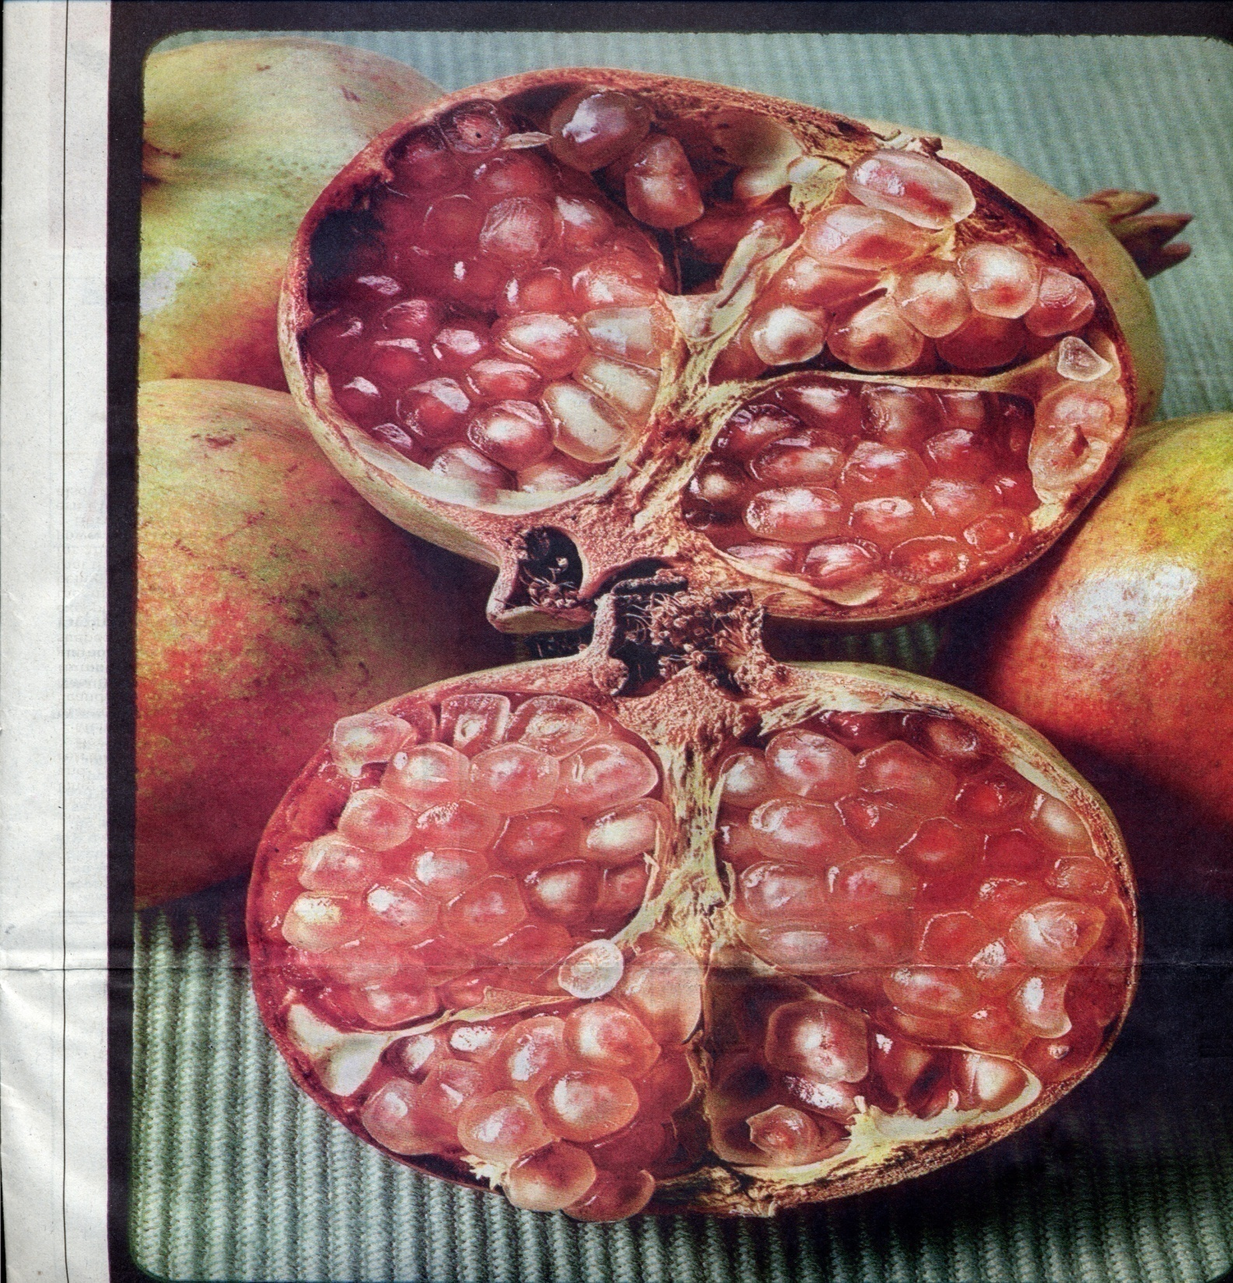

Slide 95
Ellagic Acid
Highest concentrations in pomegranate, raspberries, strawberries, walnuts
Potent antioxidant: decreases lipid peroxidation
Binds to toxic metals (nickel), promoting excretion, and hepato-protectant against toxin-induced damage
Inhibits CYP1A1 activation of carcinogens
  (e.g., N-nitroso compounds) into polar intermediates
Induces expression of phase II enzymes:
    Glutathione-S-transferase
    NAD(P): quinone reductase

Slide 96


Slide 97
Green Tea Catechins
One cup of tea contains 100-200 mg catechins
Bind to many toxic compounds
Promote healthy bowel flora and pH (enhancing detoxification)
Studies generally suggest 4-8 cups/daily to optimize effect
  Regular tea drinking inversely associated with Parkinson’s disease
  Epidemiologic studies suggest protection against many types of cancer
  Brown MD. Green tea (Camellia sinensis) extract and its possible role in the prevention of cancer. Altern Med Rev. 1999 Oct;4(5):360-70.
Notes:
“Mechanisms of action may include antioxidant and free-radical scavenging activity, and stimulation of detoxification systems through selective induction or modification of phase I and phase II metabolic enzymes.”
Brown MD. Green tea (Camellia sinensis) extract and its possible role in the prevention of cancer. Altern Med Rev. 1999 Oct;4(5):360-70.

Slide 98
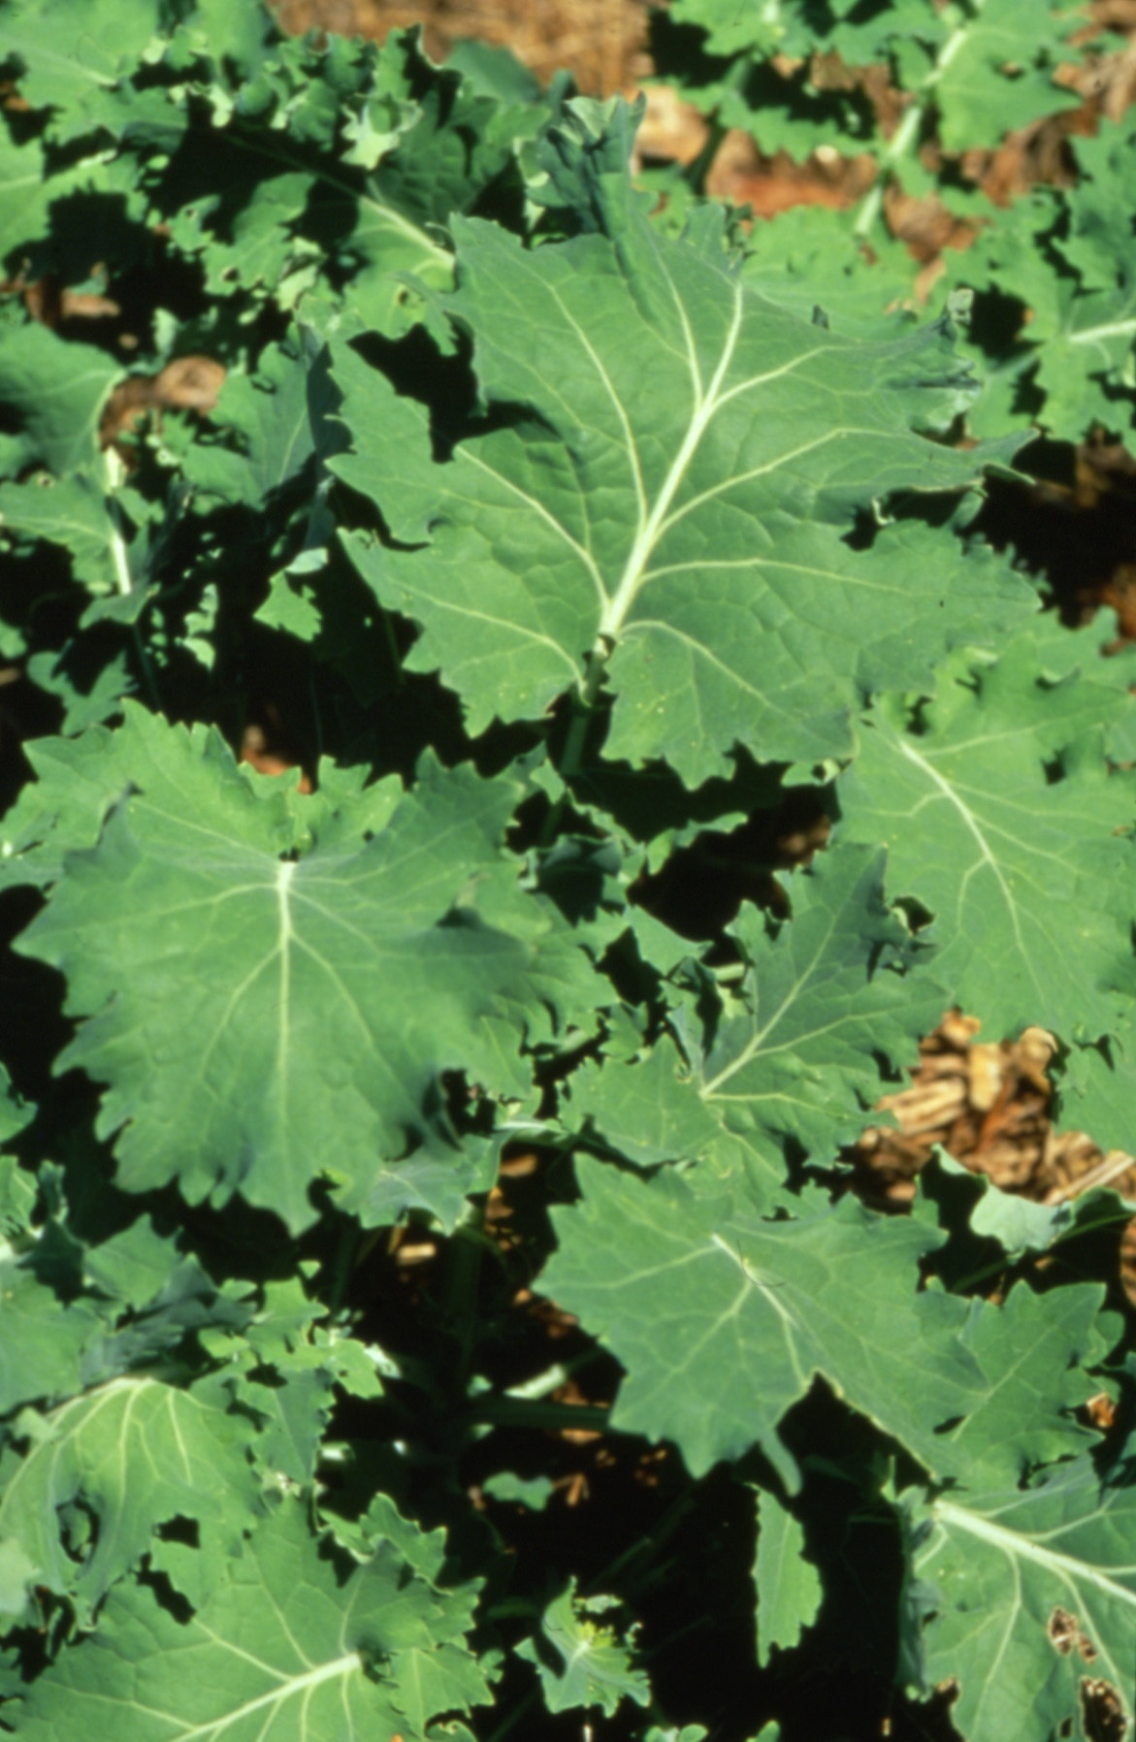
Notes:
The glucosinolates are a class of organic compounds that contain sulfur and nitrogen and are derived from glucose and an amino acid. They occur as secondary metabolites of almost all plants of the order Brassicales (including the family Brassicaceae, Capparidaceae and Caricaceae), but also in the genus Drypetes (family Euphorbiaceae)[1]. Plants use substances derived from glucosinolates as natural pesticides and as defense against herbivores; these substances are also responsible for the bitter or sharp taste of many common foods such as mustard, radish, horseradish, cress, cabbage, Brussels sprouts, kohlrabi, kale, cauliflower, broccoli, turnip, swede and rapeseed.

Slide 99
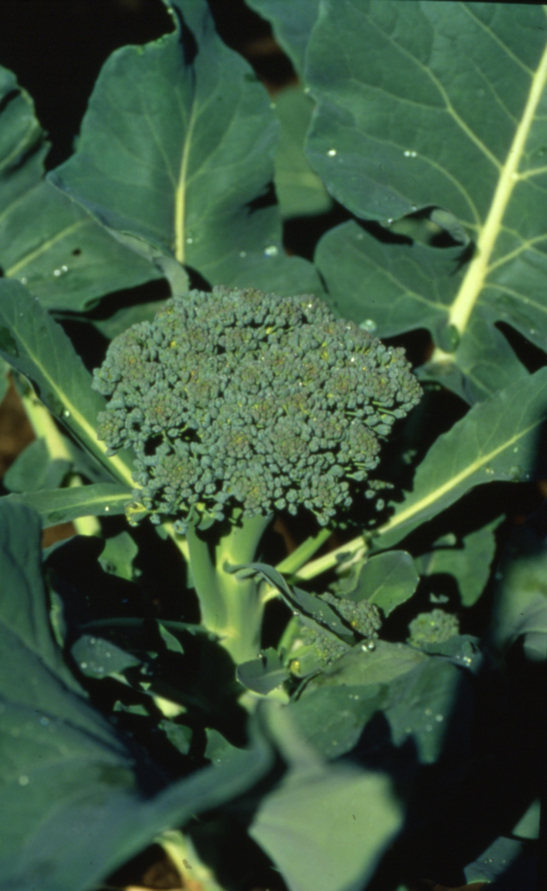

Slide 100
Glucosinolates
Precursors to bioactive isothiocyanates (ITC)
  Often hydrolyzed to ITC by enzyme myrosinase
  Or converted by gut flora (phenylethyl ITC)
  Include indole-3-carbinol, diindolylmethane, and sulphorphane
Rich sources include broccoli and watercress, but all crucifers contain glucosinolates
Bifunctional modulators
  Inhibition of specific Phase I enzymes
  Induction of Phase II enzymes
    Glucuronosyltransferases
    Glutathione-S-transferases
Notes:
Glucosinolates are relatively biologically inert but can be hydrolyzed to a range of bioactive compounds such as isothiocyanates (ITC) and indoles by the plant-based enzyme myrosinase, or less efficiently by the colonic microflora.
It appears that significant portion of the chemopreventive effects of isothiocyanates may be associated with the inhibition of the metabolic activation of carcinogens by cytochrome P450s (Phase I), coupled with strong induction of Phase II detoxifying and cellular defensive enzymes
Indole-3-carbinol (C₉H₉NO) is produced by the breakdown of the glucosinolate glucobrassicin which can be found at relatively high levels in cruciferous vegetables. Indole-3-carbinol is the subject of on-going biomedical research into its possible anticarcinogenic, antioxidant, and anti-atherogenic effects. Research on indole-3-carbinol has been conducted primarily using laboratory animals and cultured cells. Limited and inconclusive human studies have been reported. A recent review of the biomedical research literature found that, "evidence of an inverse association between cruciferous vegetable intake and breast or prostate cancer in humans is limited and inconsistent" and "larger randomized controlled trials are needed" to determine if supplemental indole-3-carbinol has health benefits^{[1]}.
Sulforaphane is an anticancer, antidiabetic, and antimicrobial compound that can be obtained by eating cruciferous vegetables such as brussel sprouts, broccoli, cabbage, cauliflower, bok choy, kale, collards, broccoli sprouts, chinese broccoli, broccoli raab, kohlrabi, mustard, turnip, radish, rocket, and watercress. The enzyme myrosinase transforms glucoraphanin (a glucosinolate) into sulforaphane upon damage to the plant (such as from chewing). The young sprouts of broccoli and cauliflower are particularly rich in glucoraphanin.
The anticancer activity of sulforaphane is thought to be related to the induction of phase-II enzymes of xenobiotic transformation (such as quinone reductase and glutathione S-transferase), and enhancing the transcription of tumor suppressor proteins. ^{[citation needed]}
Researchers at the Johns Hopkins University School of Medicine in Baltimore MD first identified sulforaphane in broccoli sprouts which, of the cruciferous vegetables, have the highest concentration of sulforaphane.^{[1]} Consumption of broccoli sprouts has shown to be effective at inhibiting Helicobacter pylori growth^{[2]} with sulforaphane being at least one of the active agents.^{[3]}
Sulforaphane and diindolylmethane (another compound from Brassica vegetables) have recently been shown to synergize together in the inhibition of cancer growth.
Optimal dosage has not yet been determined, but some doctors recommend 200 - 400 mcg of sulforaphane daily from broccoli-sprout extracts. Sulforaphane and dietary consumption of cruciferous vegetables are known to affect the action of drug-metabolizing enzymes.^{[4]} Although no side effects or direct drug interactions have been reported as of 2008, people taking prescription drugs are advised to consult a doctor before taking sulforaphane or broccoli-sprout extracts.
Sulforaphane seems to protect skin against UV radiation damage, and thus potentially against cancer, when applied topically.^{[5]}
3,3′-Diindolylmethaneor DIM is an anticarcinogen compound derived from the digestion of indole-3-carbinol, found in Brassica vegetables such as broccoli and cauliflower. ^{[citation needed]} The reputation of Brassica vegetables as medicinal plants rests in part on the activities of diindolylmethane. ^{[citation needed]}

Slide 101
Glutathione:
Master Antioxidant
Present in all living cells including the brain
Primary free radical protector for the cell
Detoxifies external toxicants, carcinogens, drugs
Maintains cell membrane stability
Maintains mitochondrial redox potential balance
Regulates protein, DNA biosynthesis, and cell growth
Enhances immunological function via lymphocytes
Prostaglandin synthesis
Amino acid transport

Slide 102
Dietary Supplements to Optimize
Reduced Glutathione Levels
Reduced glutathione, 1-3 g/day
N-acetyl cysteine, 600-3000 mg/day
Lipoic acid, 200-1000 mg/day
Whey protein concentrates, 2-3 servings/day
Magnesium, 400+ mg
Vitamin C, 500+ mg
Vitamin E, 400 IU
Pantothenic acid, 500-1000 mg/day
SAMe, 400-800 mg/day
Notes:
Picrorrhiza, 500-1500 mg/day
Silymarin, 400-1200 mg/day
Turmeric extract, pine bark, bilberry, grape extract, melatonin, theanine, strawberry/black raspberry extracts

Slide 103
Glucosinolates
Precursors to bioactive isothiocyanates
  Phenylethyl ITC (converted by gut flora)
Rich sources include broccoli and watercress
PEITC shown to inhibit chemically induced lung and colon carcinogenesis
Bifunctional modulators
  Inhibition of specific phase I
  Induction of phase II
    Glucuronosyltransferases
    Glutathione-S-transferases

Slide 104
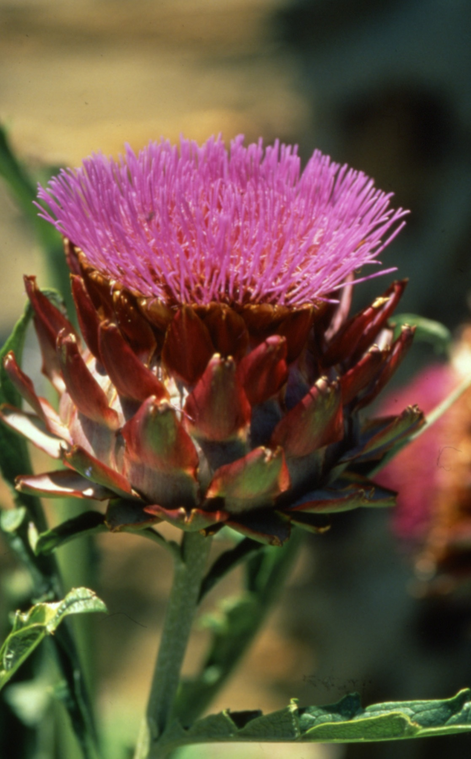

Slide 105
Silymarin (from Milk Thistle)
Flavonoid
Hepato-protectant
Potent antioxidant
Increases serum glutathione and glutathione peroxidase
Induces glutathione transferases

Slide 106
Phase II Support
Phase II can be augmented by eating cruciferous veggies and members of the onion, garlic family.
Broccoli sprouts may have higher levels of phytochemicals to aid in cancer prevention.
Nutraceuticals that have precursors for the phase II pathways can be taken.
Most of the larger nutraceutical companies have formulas that have modulators and precursors, including the “medical foods” with a hypoallergenic protein and nutrient support for the cytochrome P450 pathways.

Slide 107
Intravenous Support
Intravenous GSH 1-2 grams (during treatment or 2-3 x week)
Methylcobalamin 5 mg (5000 mcg) im 2 x week
Intravenous phospholipids (PC) 3-5 vials (Lipostabil)
SQ NAC, MF, MeCbl daily to weekly
High dose vitamin C 25-50 grams weekly
Myer’s cocktail or intravenous vitamin/minerals
Helpful for reducing side effects for very toxic patients

Slide 108
Other Considerations
Management of Side Effects and Problems
  Take a break
  Boost redox support (vitamin E, C, GSH)
  Use of intravenous therapies (GSH, PC)
  Glutathione suppositories for children
When to Stop
  When metals “normal” for unprovoked specimen
  When porphryins nl
  When “diseases” and symptom resolve
Pitfalls, Risks and Pearls

Slide 109
Traditional/Historical Approaches to Cleansing and Detoxification
Water and/or juice fasts
  Spring water only
  Fruit/vegetable juices
Liver “flushes”
  (olive oil + lemon juice)
Sauna/sweat lodges/spas
Cathartics/purges/enemas
Elemental diets
  Vivonex, etc.

Slide 110
Problems with Detoxification and Fasting
Breakdown of adipose tissue (lipolysis) in weight loss/caloric-restricted diets may result in increased “toxins” in the circulation: “the healing crisis”
Lack of fiber impedes fecal excretion and increases enterohepatic recirculation, compounding “toxin” overload.
Insufficient calories impair biotransformation in liver and gut (detoxification is highly energy dependent), compounding “toxin” overload.

Slide 111
Problems with
Detoxification and Fasting
Fasting induces phase I cytochrome P450 enzymes – leading to potential overproduction of toxic intermediates.
Lack of exogenous antioxidants + depletion of endogenous antioxidants (glutathione) may lead to inadequate quenching of free radicals.
Lack of dietary nutrient cofactors impairs phase II conjugation reactions.

Slide 112
Sweating and Detoxification

Slide 113
Hyperthermic Therapy
Far infrared sauna therapy raises the core body temperature to induce intensive sweating.

Slide 114
Physiologic Effects of Sauna
Increases peripheral circulation
Decreases circulation to muscles, kidney, and viscera
Increases metabolic rate
Increases O2 consumption
Water loss with maximal cutaneous circulation

Slide 115
What Causes Lipolysis?
Exercise
Stress
Fasting
Calorie reduction
Sauna
Get the exit routes open before adding more load to the circulation.

Slide 116
Thermal Chambers - Sauna
Increases the rate of lipolysis.
Xenobiotics in subcutaneous fat pads release through skin.
Xenobiotics from the majority of the fat goes into circulation.
How well can the body handle that?
  How well did it handle the toxins before?

Slide 117
Compounds Released in Sweat
Bromide, chloride, chromium, copper, iron, potassium, sodium, magnesium, manganese, zinc
Antimony, cadmium, lead, mercury, nickel
Urea
Methadone and two metabolites
Amphetamines and metabolites
Phenobarb, carbamazepine, and phenytoin
Other medications
PCBs

Slide 118
Pitfalls and Cautions

Slide 119
Some Common Problems in Detoxification Programs
Failure to limit/reduce exposure
Phase I pathway problems:
  Inhibition: too slow with consequent buildup of toxins
  Imbalanced: too fast relative to phase II (free radical excess)
Phase II pathway problems:
  Insufficient cofactor/nutritional support (antioxidants, cofactors, conjugating agents)

Slide 120
Some Common Problems in Detoxification Programs
Lowered urinary excretion through inadequate hydration
Biliary-colonic excretion problems
  Insufficient bile flow
  Excessive enterohepatic recirculation
    Deconjugation by microflora
    Constipation
Failure to address GI dysfunction (“Autointoxication”)

Slide 121
Variables to Clinical Responses
Genetic limitations on detoxification (phenotypic status)
Genetic predisposition to toxicant-related illness such as autoimmunity and cancer
General health, current/past illnesses, medications
Quantity, intensity, duration, and diversity of exposure
Diet and antioxidant status
Age and gender
GI flora and bowel frequency

Slide 122
Metal Detox: Pearls
        Mobilizing heavy metals judiciously and carefully according to established protocols, can substantially move the physiology toward a homeodynamically balanced state.
        In the chronically ill patient who has compromised GI, liver, and renal function and who is nutritionally deficient, starting with chelation therapy can backfire unless the other areas are dealt with first.
It is wise to get thorough training through:
  American Board of Clinical Metal Toxicology or
  American College for Advancement in Medicine

Slide 123
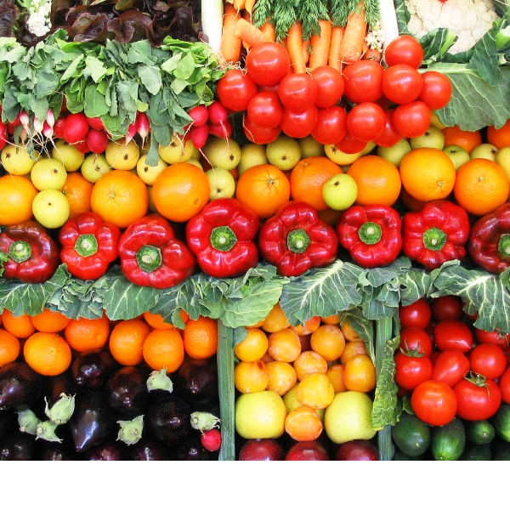

Slide 124
